Slide 1
DDL: View, Index, Sequence, Synonym

Slide 2
AGENDA
What is view
Create/Alter/Drop View
What is Index
Create/ Alter/Drop Index
What is Sequence
Create/Alter/Drop Sequence
What is Synonyms.

Slide 3
View
What is View?
View is a virtual table that consists of subsets of columns from single or multiple tables.
A sub query may return you single row of data or multiple row of data.
Properties:
A view helps simplify the complexity of a query because you can query a view, which is based on a complex query, using a simple SELECT statement.
Like a table, you can grant permission to users through a view that contains specific data that the users are authorized to see.
A view provides a consistent layer even the columns of underlying table changes
© Elait Limited. Confidential

Slide 4
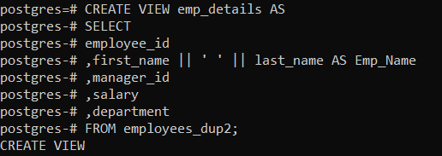
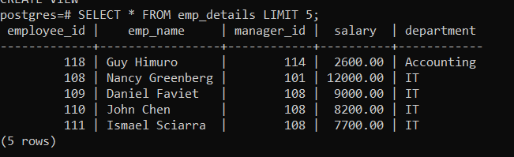
View Continue..
Single table view:
CREATE VIEW emp_details AS SELECT employee_id,
first_name || ' ' || last_name as Emp_Name,
manager_id, salary, department FROM employees_dup2;
© Elait Limited. Confidential

Slide 5
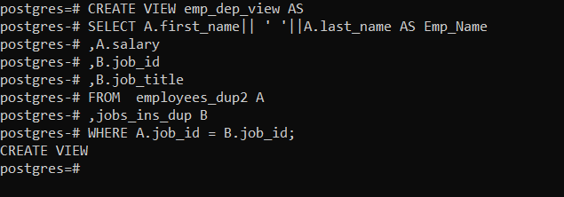
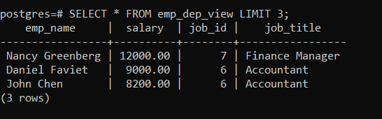
View Continue..
View using multiple tables:
CREATE VIEW emp_dep_view AS SELECT A.first_name|| ' '||A.last_name AS Emp_Name ,A.salary ,B.job_id
,B.job_title
FROM employees_dup2 A
,jobs_ins_dup B
WHERE A.job_id = B.job_id;
© Elait Limited. Confidential

Slide 6

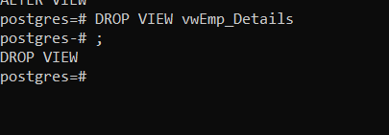
View Continue..
Alter view:
ALTER VIEW emp_details RENAME TO vwEmp_Details
Create or Replace Existing View
CREATE OR REPLACE VIEW VWEmp1 AS SELECT EMPNO,DNAME, SAL FROM EMP_DUP
INNER JOIN DEPT_DUP
ON EMP_DUP.DEPTNO=DEPT_DUP.DEPTNO
WHERE JOB='SALESMAN';
Drop view:
DROP VIEW vwEmp_Details
© Elait Limited. Confidential

Slide 7

Index
What is Index?
Indexes are special lookup tables that the database search engine can use to speed up data retrieval.
Simply put, an index is a pointer to data in a table.
It is very similar to an index in the back of a book.
Indexing feature can be used to obtain fast access to data based on some transformation of the basic data.
Cluster Index is created by default when a primary key is defined to the table.
Create Index
CREATE INDEX Index_sal ON employees_dup2 (Salary Desc);
© Elait Limited. Confidential

Slide 8
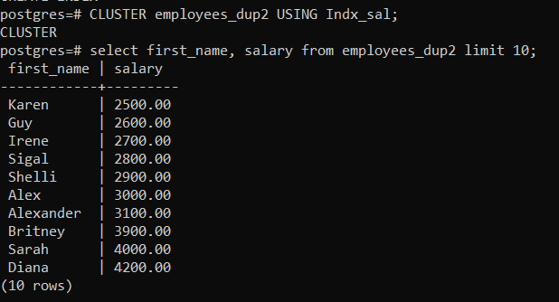
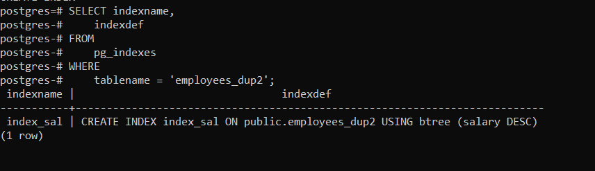
Index Continue..
Cluster Index:
CLUSTER employees_dup2 USING Indx_sal;
View Index
CREATE INDEX Index_sal ON employees_dup2 (Salary Desc);
© Elait Limited. Confidential

Slide 9
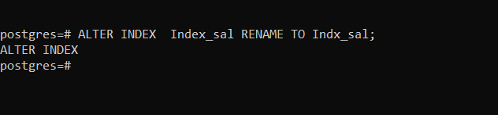
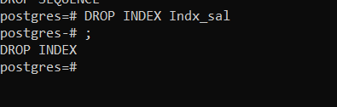
Index Continue..
Alter Index
ALTER INDEX Index_sal RENAME TO Indx_sal
Drop Index
DROP INDEX Indx_sal
© Elait Limited. Confidential

Slide 10

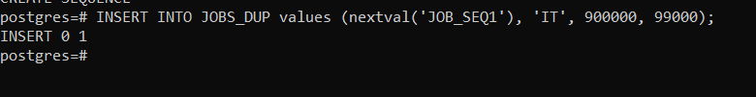
Sequence
What is Sequence?
Sequence is a set of integers 1, 2, 3, … that are generated and supported by some database systems to produce unique values
A sequence in PostgreSQL is a user-defined schema-bound object that generates a sequence of integers based on a specified specification.
Create Sequence
CREATE SEQUENCE JOB_SEQ1 start 400;
Insert Sequence:
INSERT INTO JOBS_DUP values (nextval('JOB_SEQ1'), 'IT', 900000, 99000);
© Elait Limited. Confidential

Slide 11

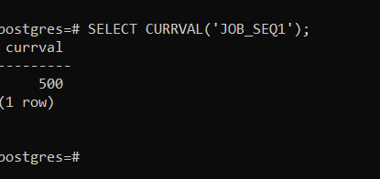
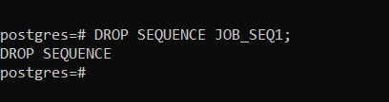
Sequence Continue..
Alter Sequence
ALTER SEQUENCE JOB_SEQ1 restart start with 500;
SELECT CURRVAL('JOB_SEQ1');
Drop Sequence
DROP SEQUENCE JOB_SEQ1;
© Elait Limited. Confidential

Slide 12
Sequence
What is Sequence?
Sequence is a set of integers 1, 2, 3, … that are generated and supported by some database systems to produce unique values.
A sequence in PostgreSQL is a user-defined schema-bound object that generates a sequence of integers based on a specified specification.
Create Sequence
CREATE SEQUENCE JOB_SEQ1 start 400;
Insert Sequence:
INSERT INTO JOBS_DUP values (nextval('JOB_SEQ1'), 'IT', 900000, 99000);
© Elait Limited. Confidential

Slide 13
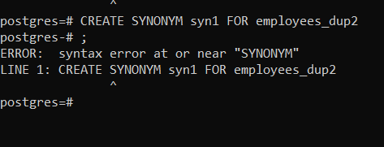
Synonyms
What is Synonyms?
A SYNONYM provides another name for database object, referred to as original object, that may exist on a local or another server.
It is used to simplify accessing the objects by creating another name for the object.
We can also say Synonym is an alias of the object.
To create a synonym, a user should have admin access.
The database administrator can create a public synonym accessible to all users and can specifically grant the CREATE PUBLIC SYNONYM privilege to any user, and that user can create public synonyms
Create Synonym:
CREATE SYNONYM syn1 FOR employees_dup2;
Drop Synonym:
DROP SYNONYM syn1;
© Elait Limited. Confidential

Slide 14
Thank You
© Elait Limited. Confidential

